Slide 1

CS5220 - Final Presentation
REDIS
Alejandro Trejo
Bingnan Zhou
Dat Dang
Hasanain Al Sabonchi
Amir Ebrahimi

Slide 2
Redis vs. Other Databases
Database | Type | Data Storage | Query Type
Redis | Key-value store | Strings, lists,hashes, set, sorted sets | Commands for each Data Type
MySQL | Relational | Table, rows, Columns | Select, Insert, Delete, Update
MongoDB | Non-relational | Schemaless BSON documents | Commands for create, read, update, delete, conditional queries
Memcached | Key-Value store | Strings | Commands for create, read, update, delete, and a few others

Slide 3
Additional Features
Atomic Operations
Transactions
Master/Slave Replication
Disk Persistence
RDB file
AOF file
Key Expiration

Slide 4
How to install (https://redis.io/download)
Mac OS
$ wget https://download.redis.io/releases/redis-6.0.9.tar.gz
$ tar xzf redis-6.0.9.tar.gz
$ cd redis-6.0.9
$ make
Ubuntu
$ sudo add-apt-repository ppa:redislabs/redis
$ sudo apt-get update
$ sudo apt-get install redis

Slide 5
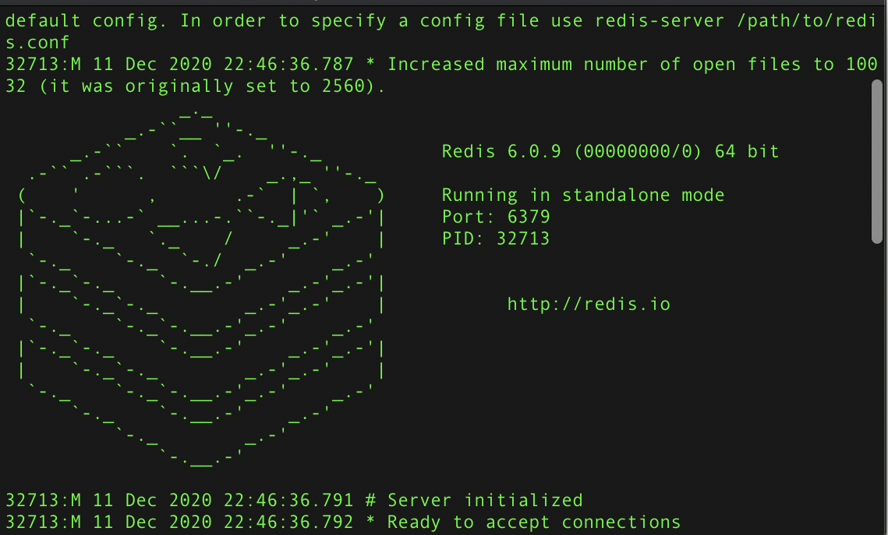
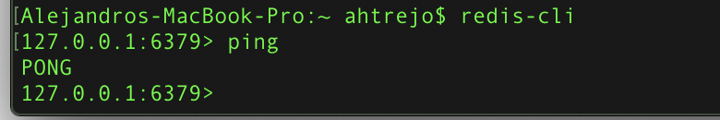
How to Start up
Server
$ Redis-server
Command Line
$ Redis-cli

Slide 6
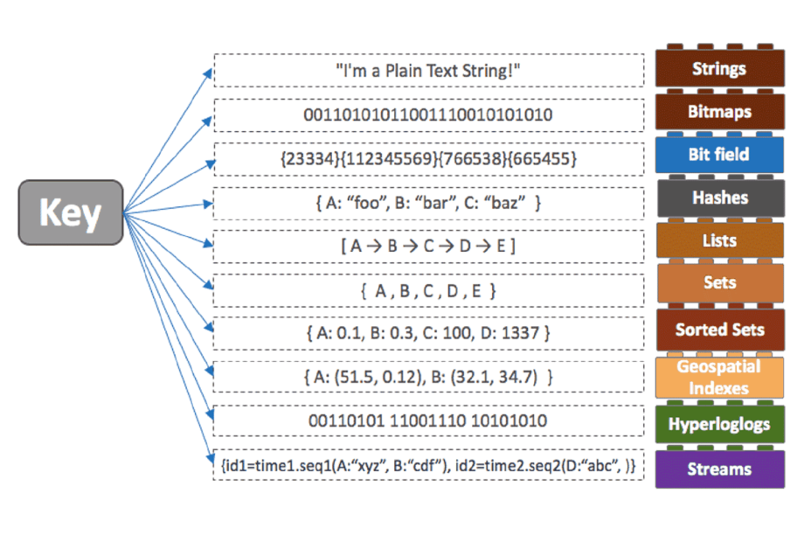
Data Structures (Types)
Bingnan Zhou

Slide 7
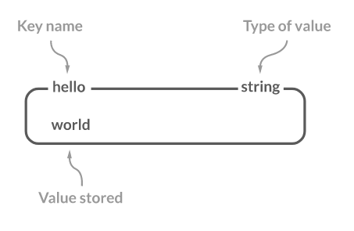
Data Structure - Strings
Binary-safe data structure
Includes:
Normal string
Integer
Floating point value
JPEG image data
Serialized Ruby object
etc ...
Allows many operations
Increment
Decrement
etc ...
Bingnan Zhou

Slide 8
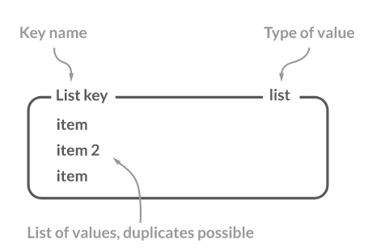
Data Structure - List
Holds collections of strings
Users can
Push (Add)
Fetch
Pop (Remove)
Trim based on offsets
Bingnan Zhou

Slide 9
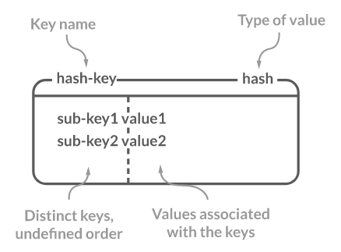
Data Structure - Hashes
Stores a set of field-value pairs
Provides the ability to:
Add
Fetch
Remove
Bingnan Zhou

Slide 10
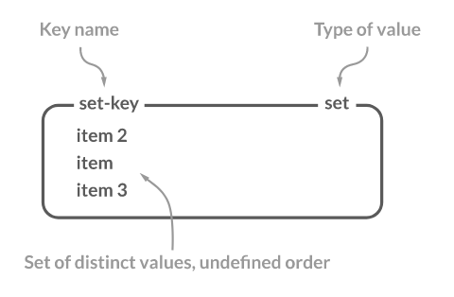
Data Structure - Sets
Stores a unique set of members
Users can
Add
Fetch
Remove
Check membership
Retrieve random member
Allows many operations
Intersection
Union
Set difference
Bingnan Zhou

Slide 11
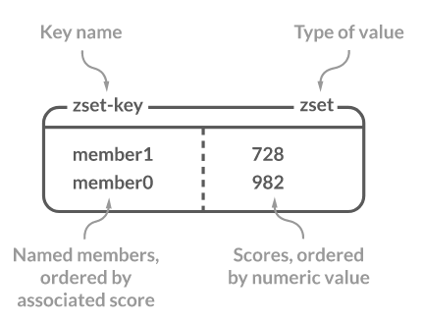
Data Structure - Sorted Sets
Stores a unique set of members ordered by floating-point scores
Users can
Add
Fetch
Remove
Allows many operations
Intersection
Union
Set difference
Bingnan Zhou

Slide 12
Data Structures - Conclusion
Designed with developers in mind
Avoiding the overhead associated with the conversion between application objects to database entities for every database operation.
Less space and faster in-memory processing
Backbone for many popular Redis use cases
Caching
Messaging
Gaming
Streaming
etc ...
Bingnan Zhou

Slide 13
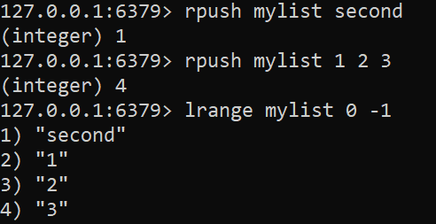
Some Common Redis Commands (List)

Slide 14
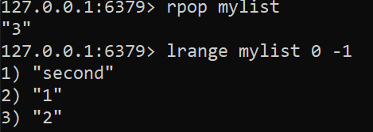
Some Common Redis Commands (List)

Slide 15
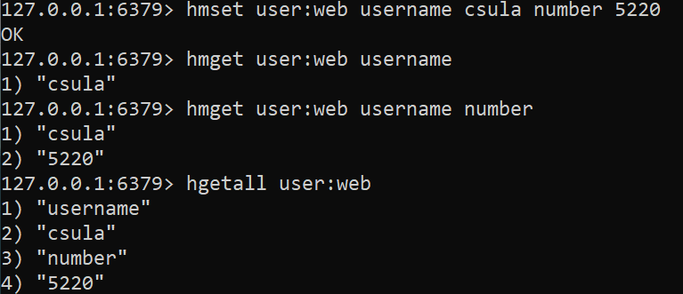
Some Common Redis Commands (Hash)

Slide 16
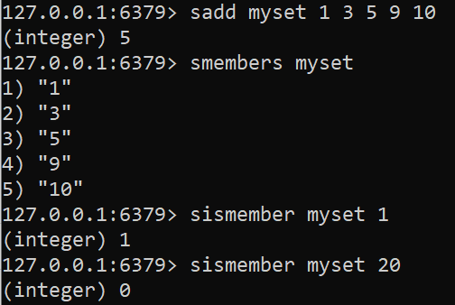
Some Common Redis Commands (Set)

Slide 17
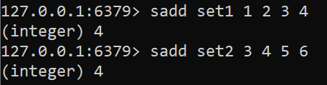
Some Common Redis Commands (Set)

Slide 18
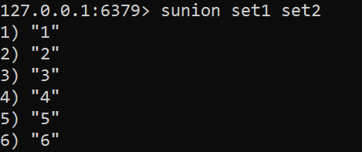
Some Common Redis Commands (Set)

Slide 19

Some Common Redis Commands (Set)

Slide 20
Resources to Additional Command
https://redis.io/commands

Slide 21
Demo

Slide 22
Use Cases of Redis in ‘Web Application’
Login and cookie caching
Shopping carts in Redis
Web page caching
Database row caching
Web page analytics
Amir Ebrahimi

Slide 23
Login and cookie caching
Signed Cookies
e.g. user’s name, privileges, user ID, last logged in, and etc.
Verification signature
Amir Ebrahimi

Slide 24
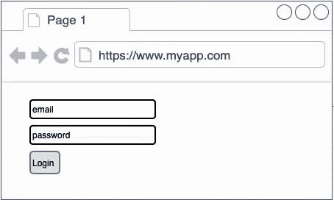
Session-based authentication/authorization using Redis
POST /login
{
“email”: “amir@gmail.com”,
“password”: “12345”
}
Server
1
2
5
Relational / NoSQL DB
3
Compare password hashes
Fetch user associated with email and password hash from database
Return cookie that contains the user’s session id
(e.g. sessionId1)
4
Create session
{
“sessionId”: {
“roles”: {“ADMIN”},
“locale”: “EN”
}
}
Redis
session store
Amir Ebrahimi

